Slide 1

Methodist College of Engineering & Technology
Project Team: 961CS-A05
Domain: Machine Learning
Project Title: Voice Based Email System
Guide Name: Ms. Unnati K
S. No. | Roll no. | Student Name | Role in Team
1 | 160717733008 | T SAI CHARAN REDDY | Team Leader
2 | 160717733004 | N GAGAN KUMAR | Team Member
3 | 160717733032 | A SREEKAR | Team Member
Under the guidance of Project Coordinator
Ms. Unnati K Mr. M. Krishnamurthy
Assistant Professor Assistant Professor
Department of CSE Department of CSE

Slide 2
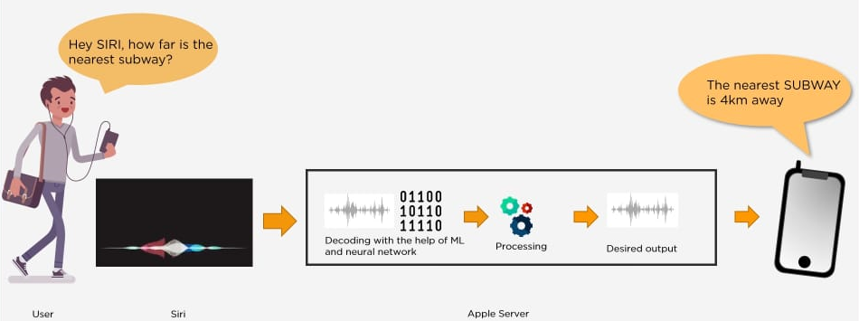
DOMAIN: MACHINE LEARNING
Machine learning is an application of artificial intelligence (AI) that provides systems the ability to automatically learn and improve from experience without being explicitly programmed. Machine learning focuses on the development of computer programs that can access data and use it to learn for themselves on the basis of past experience.

Slide 3
ABSTRACT
As the technology is enhancing, people are coming closer to digital life and digital communication. In this new advanced era there are many ways to communicate with others through internet in this new advanced era.
E-mail is one of the technologies that enables user to contact with others by sending mails and also helps in business world communication.
There are people who cannot use these technologies because either they are illiterate or do not have ability to view the screen. So, to make this technology closer to visually challenged people we proposed a Voice Based E-mail System.
This architecture will help visually challenged people to access e-mail. This system provides them the facility to communication and make them much stronger and independent.

Slide 4
CONTENTS
Introduction
Rationale
Objectives
Literature Survey
Existing System
Proposed System
Feasibility Study
Project Planning
Gantt Chart
Facilities Required for the proposed work

Slide 5
System Design
System Architecture
DFD’S
UML Diagrams
Modules
Implementation
Algorithms
Test cases
Observations and results
Screenshots
Conclusion
Future scope
Bibliography as per IEEE format

Slide 6
INTRODUCTION
We have seen that the introduction of Internet has revolutionized many fields. Communication is one of the main fields which is changed by Internet.
E-mails are the most dependable way of communication over Internet, for sending and receiving some important information. But there is a certain norm for humans to access the Internet and the norm is we must be able to see.
But there are also differently abled people in our society who are not gifted with what we have. There are some visually impaired people who can’t see the computer screen or keyboard.

Slide 7
RATIONALE
A survey has shown that there are more than 240 million visually impaired people around the globe. That is, around 240 million people are unaware of how to use Internet or E-mail.
The only way by which a visually challenged person can send an E-mail is, they have to speak the entire content of the mail to another person(not visually challenged) and then that third person will compose the mail and send on the behalf of the visually challenged person.
But this is not a right way to deal with the problem. It is very unlikely that every time a visually impaired person can find someone for help.

Slide 8
OBJECTIVE
The application will be a python-based application. For visually challenged persons we use IVR- Interactive voice response.
Everyone can control their mail accounts using their voice and can be able to read, send, and perform all the other useful tasks.
This project aims to help the visually impaired people to be a part of growing digital India by using internet and also aims to make life of such people quite easy.

Slide 9
LITERATURE SURVEY
1.Voice Based System in Desktop for Blind People
- Jagtap Nilesh, Pawan Alai
This paper describes the voice mail architecture used by blind people to access E-mail and multimedia functions of operating system easily and efficiently. This architecture will also reduce cognitive load taken by blind to remember and type characters using keyboard. It also helps handicapped and illiterate people.

Slide 10
2. An Interactive Email for Visually Impaired
- G. Anusha , V. Jeevitha
This paper explains the design and implementation of an interactive system for visually challenged people. Web accessibility stands as the inclusive practice of creating web based applications that can be used by people of all kind.
The very basic and important need for using the internet is accessing emails. Micro systematic applied research has been done on how a visually challenged user can have an access to his emails and this paper completely concentrates in filling few gaps in doing that.

Slide 11
3. Voice Based Search Engine and Web page Reader
-Ummuhanysifa U.,Nizar Banu P K
This paper aims to develop a search engine which supports Man-Machine interaction purely in the form of voice. A novel Voice based Search Engine and Web-page Reader which allows the users to command and control the web browser through their voice, is introduced. The existing Search Engines get request from the user in the form of text and respond by retrieving the relevant documents from the server and displays in the form of text.

Slide 12
EXISTING SYSTEM
Composing, reading and sending mail is a challenge to visually impaired as they can’t type through keyboard.
The way by which a visually challenged person can send an E-mail is, they have to speak the entire content of the mail to another person(not visually challenged) and then second person will compose the mail and send on the behalf of the visually challenged person. But this is not a right way to deal with the problem.

Slide 13

PROPOSED SYSTEM
This application provide a voice based mailing service where they could read and send mail on their own. Here, the users have to use certain keywords which will perform certain actions for e.g. Read, Send, Compose Mail etc.
One of the major advantages of this system is that user won’t require to use the keyboard.

Slide 14
PROJECT PLANNING - GANTT CHART
Task
Understanding domain
Finalization abstract
Analysis
Design
Development
Testing
Finalization
February March April

Slide 15
FACILITIES REQUIRED FOR PROPOSED WORK
Software Requirements
Python IDE’s ( Jupyter, PyCharm , anaconda ,etc.. )
Pyttsx - text to speech api in python.
Google Speech-to-text and text-to-speech Converters.
Windows Operating System.
Hardware Requirements
RAM: 2 GB
Disk Space: 100 GB
Desktop / Laptop

Slide 16
SYSTEM DESIGN
System Architecture
DFD’S
UML Diagrams
Class Diagram
Use Case Diagram
Sequence Diagram
Activity Diagram
State Chart Diagram
Deployment Diagram

Slide 17
SYSTEM ARCHITECTURE
FRIEND
REGISTER BLIND USER
SERVER
SEND/READ EMAIL
VISUALLY IMPAIRED USER
SPEECH COMMAND
NOTIFY USER
EMAIL SERVER
RECOGINZE SPEECH
APPLICATION
VOICE MESSAGE
LISTEN USER
TEXT TO SPEECH
SEND EMAIL NOTIFICATION
SPEECH TO TEXT

Slide 18
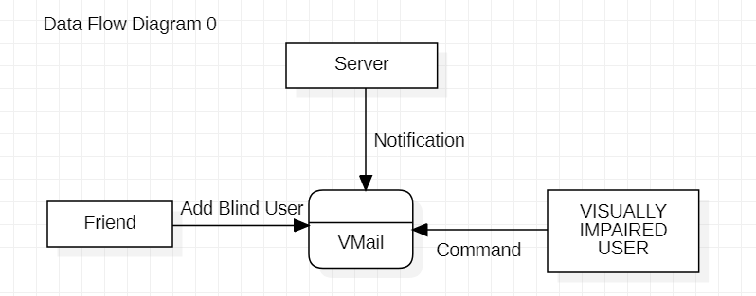
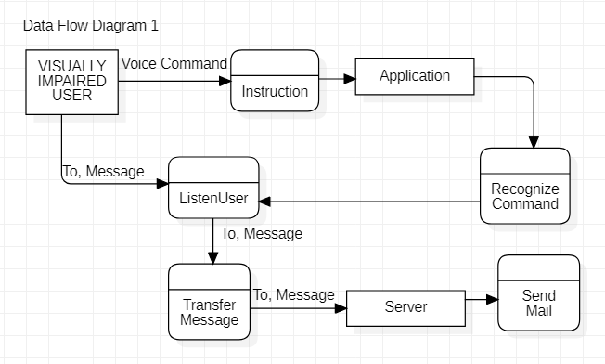
DATA FLOW DIAGRAM

Slide 19
UML DIAGRAM’S

Slide 20
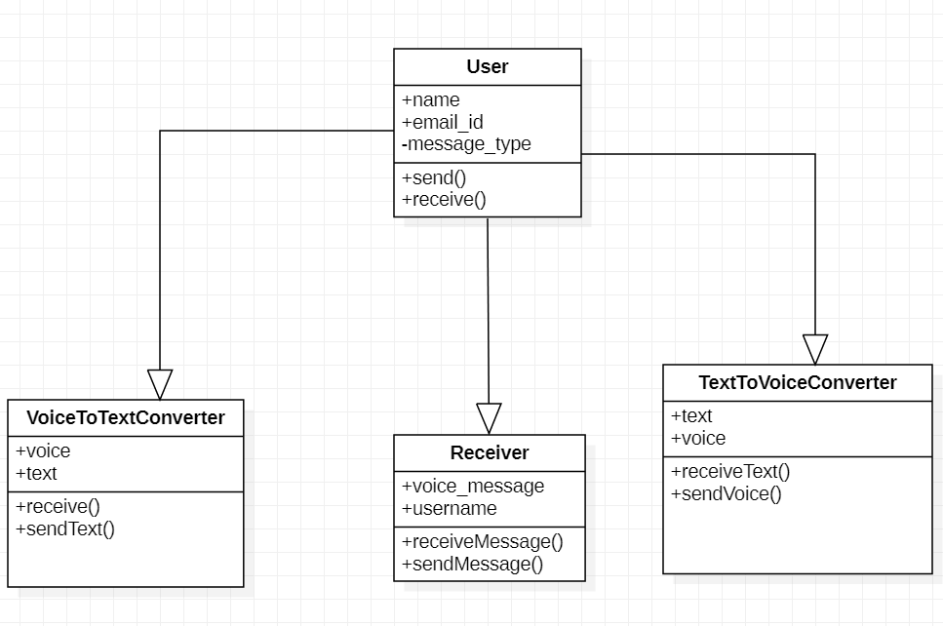
CLASS DIAGRAM

Slide 21
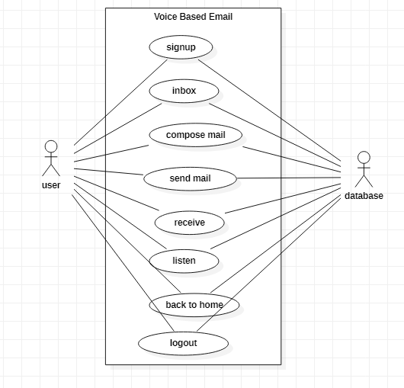
USE CASE DIAGRAM

Slide 22
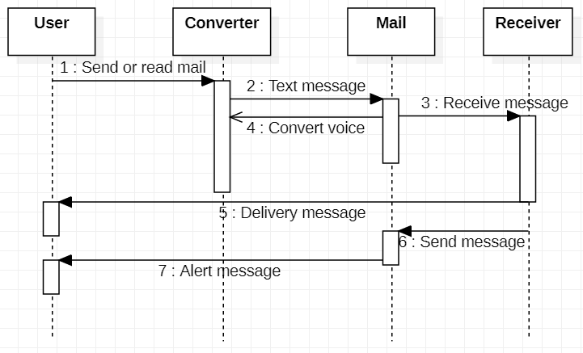
SEQUENCE DIAGRAM

Slide 23
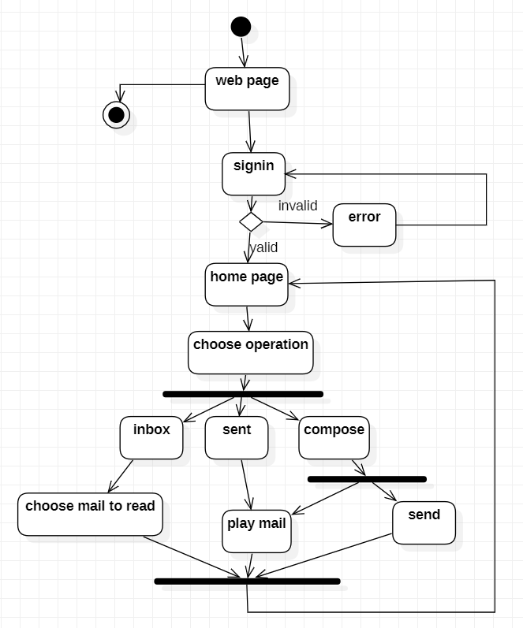
ACTIVITY DIAGRAM

Slide 24
STATE CHART DIAGRAM
User
Voice to text converter
Alter message
Send text
Send message
Send voice
Voice based email
Voice message
Delivering report
Receiver
Voice message
Text message
Text to voice converter

Slide 25
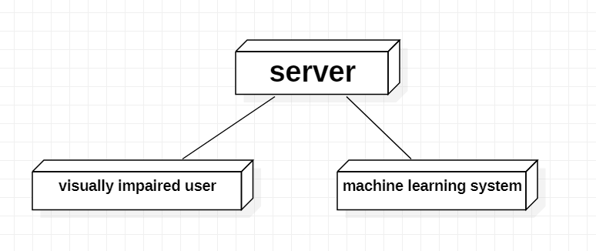
DEPLOYMENT DIAGRAM

Slide 26
MODULES
Voice Based Email:
The following operations can be performed in the application are :
Voice Based email
Compose mail
Checking Inbox
Smart Computer
Accessing Drives
Opening Applications
Exit

Slide 27
IMPLEMENTATION ALGORITHM
For voice based email system, we used speech recognition, pyttsx3, gTTS (packages) which is open source and free to use.
For connecting with Gmail server, we used imaplib, email packages.
All the operations on mails are done with the help of commands which are defined in the application.

Slide 28
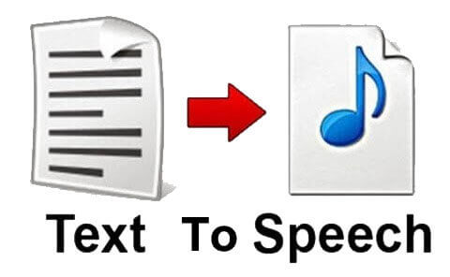
TEXT TO SPEECH:
It converts normal text messages into speech format. A normal text can be heard through audio file. The input is a plain text and the output is in audio format which can only be heard. Each word can be heard through sound and the blind person can successfully be able to read the whole message using this API.

Slide 29
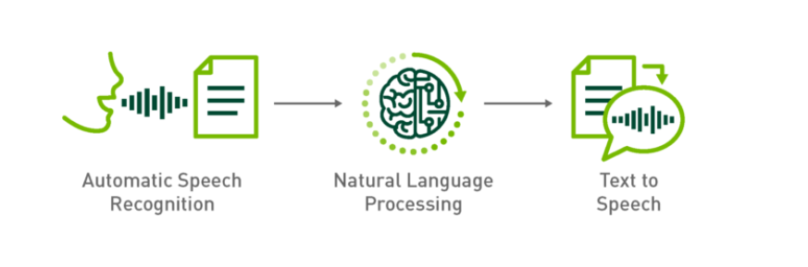
SPEECH RECOGNITION:
It is used for individuals to perform actions through voice instead of using keyboard. This software takes input through voice and saves in mp3 format. After saving, it performs particular task and delete after the function is over. The user dictates the messages and the system accepts the message in voice format.

Slide 30
IMAP:
Internet message access protocol is used to fetch mails from Gmail so that the receiver can read the messages easily. The received messages are in the Gmail itself IMAP helps the user to connect to Gmail.
SMTP:
Simple mail transfer protocol helps to connect to Gmail. It helps in composing mails. It also acts as a connection to Gmail which helps in send of mails.

Slide 31
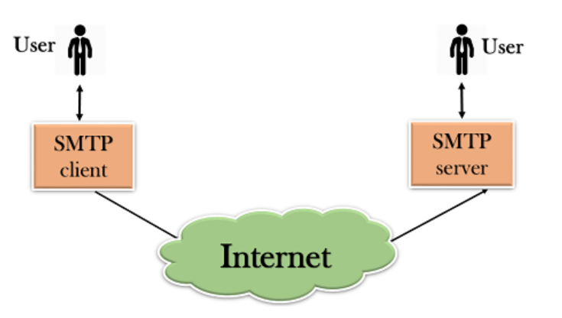

Slide 32
TEST CASES
TEST CASE 1
Test case 1: Verifying the Voice Based Email |  | Priority (H, L): High
Test Objective: To verify Voice Based Email
Test Description: Voice Operations like Composing mails Reading unseen mails(Inbox)
Requirements Verified: Yes
Test Environment: Windows 7 system and newer , 4GB RAM, i3 processor.
Actions | Expected Results
Doing operation with Voice commands | Outputs of all voice commands
Pass: Yes Conditions pass: Yes Fail: No
Problems / Issues: NIL
Notes: Successfully Executed

Slide 33
TEST CASE 2
Test case 2: Smart Computer |  | Priority (H, L): High
Test Objective: To verify Smart Computer
Test Description: Voice Operations like Opening drives(C-drive , D-drive ) Opening applications(Facebook , chrome)
Requirements Verified: Yes
Test Environment: Windows 7 system and newer , 4GB RAM, i3 processor.
Actions | Expected Results
Doing operation with Voice commands | Outputs of all voice commands
Pass: Yes Conditions pass: Yes Fail: No
Problems / Issues: NIL
Notes: Successfully Executed

Slide 34
OBSERVATION AND RECORD
We had observed all the operation and voice commands are running successfully with some limitations.
This application will not work if the user is unable to speak .
Pronunciation should be accurate.
System should be connected with microphone.
The project was successfully implemented and executed.

Slide 35
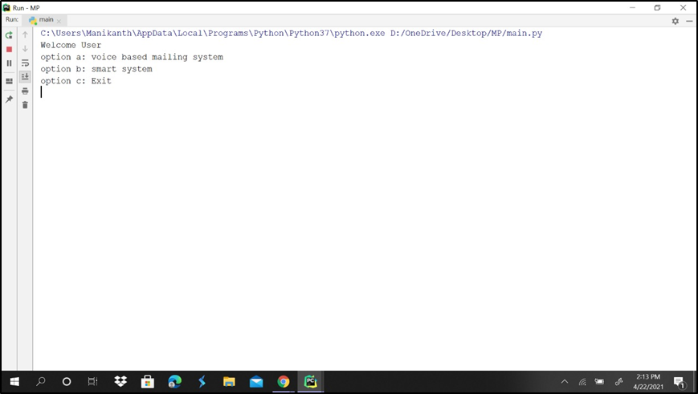
SCREENSHOTS
Screenshot of menu page

Slide 36
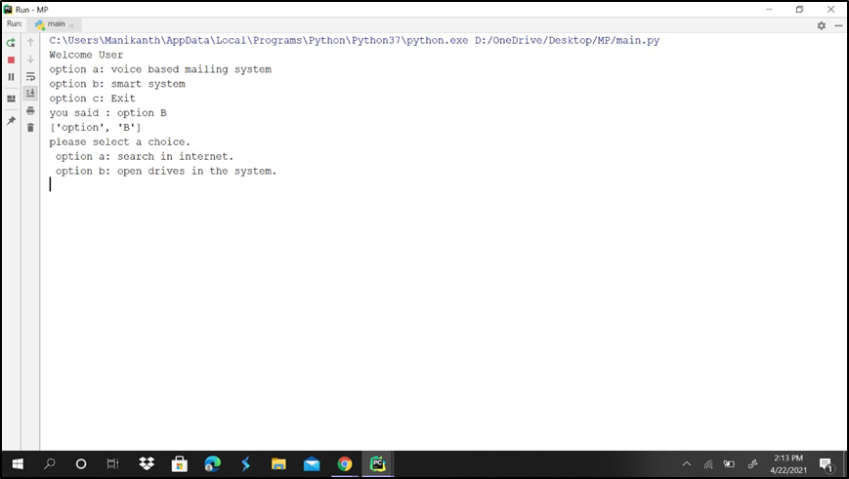
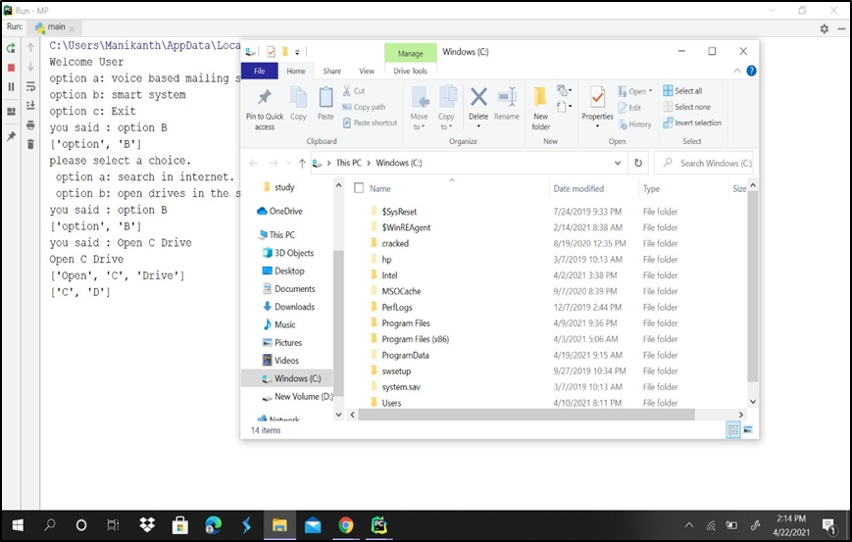
Screenshot of menu page for smart system
Screenshot of opening drives system

Slide 37
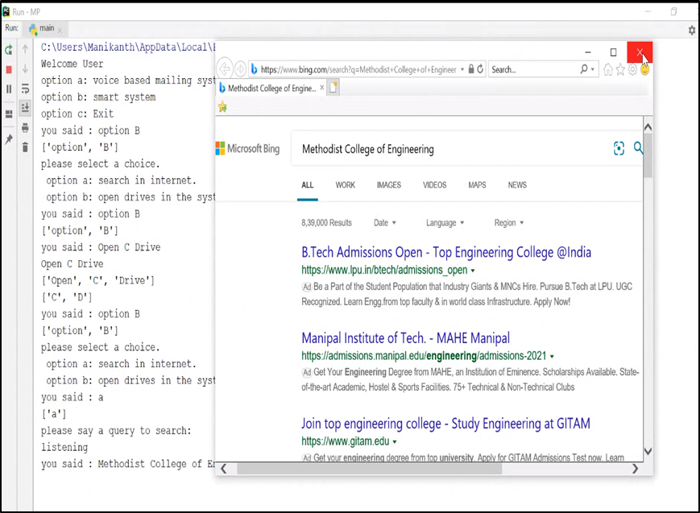
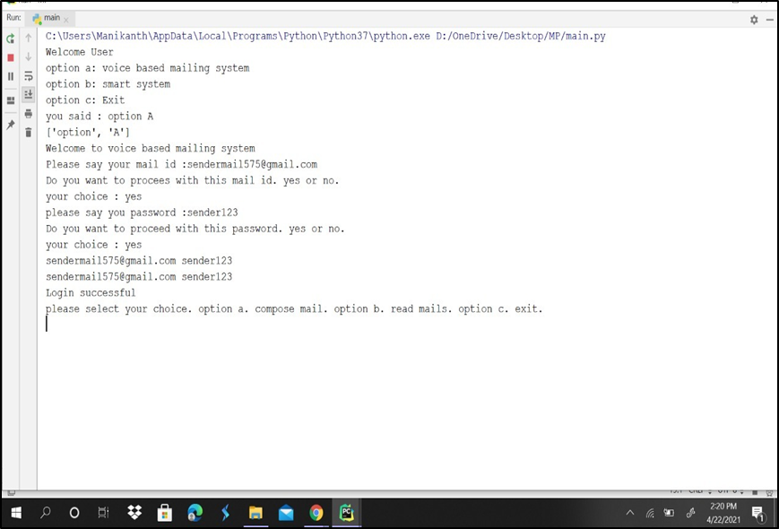
Screenshot of search in internet
Screenshot of menu page for voice based email system

Slide 38
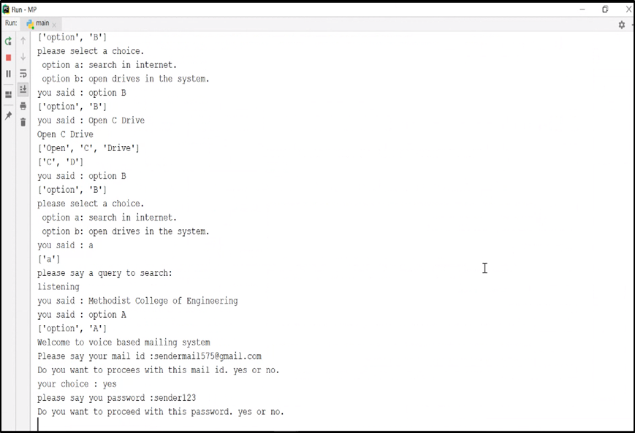
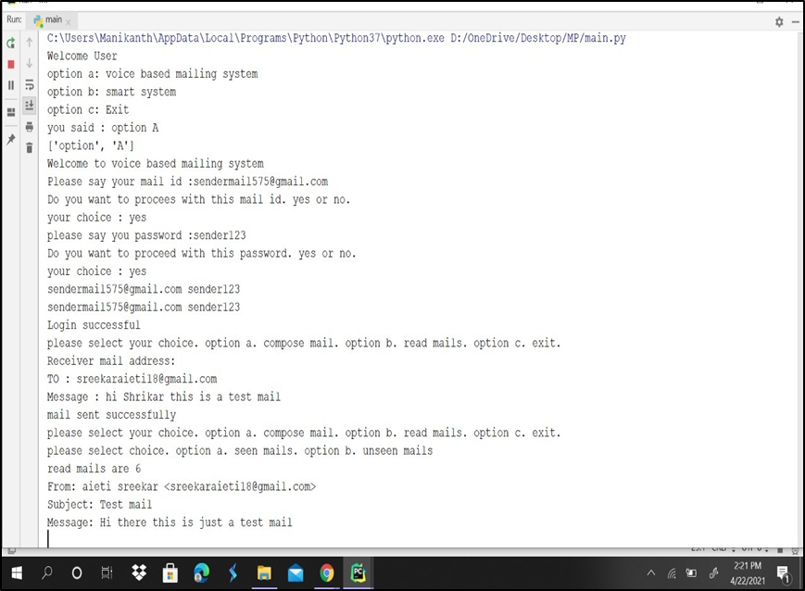
Screenshot of login to Gmail
Screenshot of sending mail

Slide 39
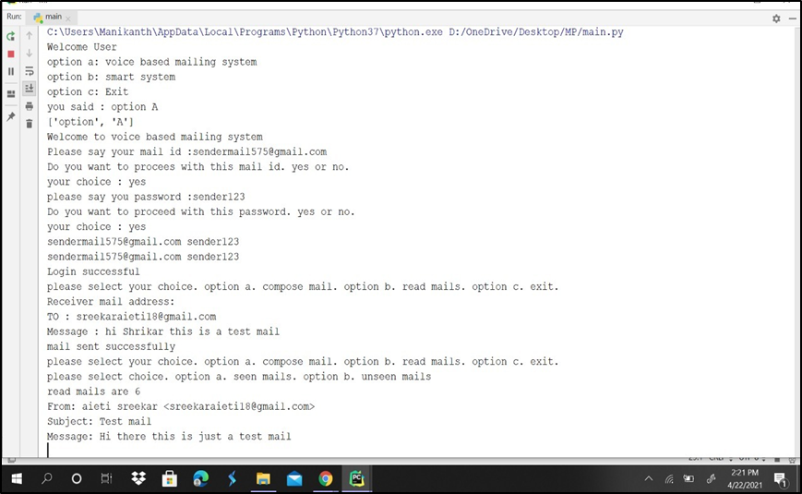
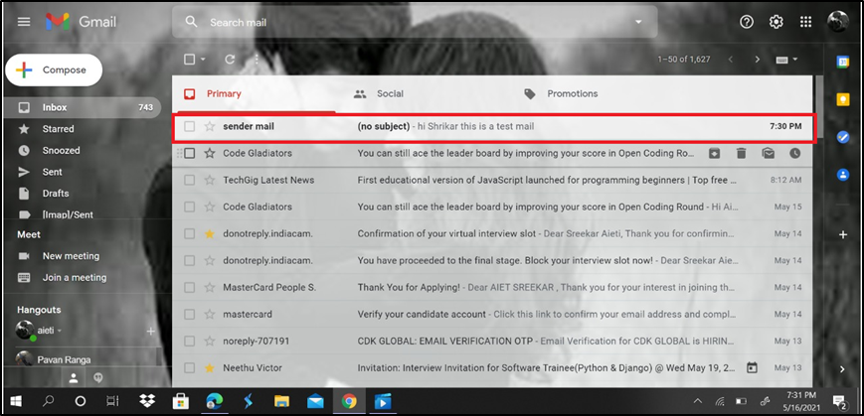
Screenshot of read mail
Screenshot of received mail

Slide 40
CONCLUSION
We have proposed an application which will help the visually impaired people to access the email services easily and efficiently.
This system will help in overcoming certain issues that the visually impaired people had to face earlier in using email systems.
Also we have completely eliminated the concept of using keyboard shortcuts and also the use of screen readers which may help in reducing the stress load of remembering the location of the keys on the keyboard. And user can use this system efficiently.

Slide 41
FUTURE SCOPE
Voice could be extended to image attachments and other options such as indentation, fonts, file attachment, downloading the file etc., that are available as in normal E-Mail.
Advanced features like accessing any particular file on a computer with the help of voice commands can be added to the application.

Slide 42
BIBILOGRAPHY
• Ummuhanysifa U.,Nizar Banu P K , “Voice Based Search Engine and Web page Reader”. In International Journal of Computational Engineering Research (IJCER). Pages 1-5.
• G. Shoba, G. Anusha, V. Jeevitha, R. Shanmathi. “AN Interactive Email for Visually Impaired”. In International Journal of Advanced Research in Computer and Communication Engineering (IJARCCE), 2014 on Pages 5089-5092.
• Jagtap Nilesh, Pawan Alai, Chavhan Swapnil and Bendre M.R.. “Voice Based System in Desktop and Mobile Devices for Blind People”. In International Journal of Emerging Technology and Advanced Engineering (IJETAE), 2014 on Pages 404-407 (Volume 4, issue 2).

Slide 43
ANY QUERIES??

Slide 44
THANK YOU!!

